Slide 1
Chapter 13
Endocrine System

Slide 2
Overview
Hormones
Hormone receptor… Targets
Control of hormone secretion
Major endocrine glands
Role of hypothalamus
Role of the pituitary gland
Specific gland and hormones

Slide 3
The Endocrine System
Consists of a group of glands that produce hormones
Works with nervous system to control and coordinate all other body systems
Effects body systems by chemical stimuli

Slide 4
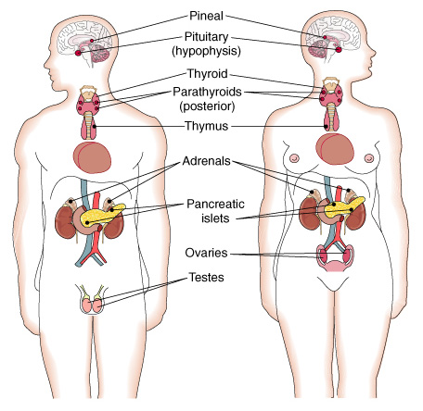
The endocrine glands.

Slide 5
Hormones
Chemical messengers with regulatory effects on cells or organs
Some affect many tissues
  Growth hormone
  Thyroid hormone
  Insulin
Some affect a specific tissue (target tissue)
  Thyroid-stimulating hormone (TSH)
  Adrenocorticotropic hormone (ACTH)

Slide 6
Hormone Chemistry
Amino acid compounds
  Proteins or related compounds
  All hormones except steroids
Steroids
  Lipids derived from the steroid cholesterol
  Produced in adrenal cortex and sex glands

Slide 7
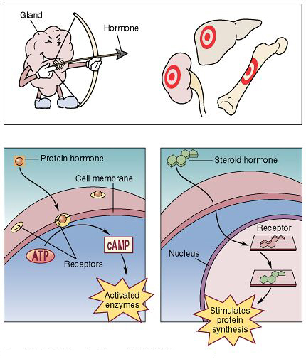
Hormone receptors

Slide 8
Checkpoint 13-1: What are hormones and what are some effects of hormones?

Slide 9
Hormone Regulation
Negative feedback (most common)
  Endocrine gland oversecretes hormone
  Tissue becomes too active
  Tissue negatively effects gland to decrease secretion
Positive feedback
  Hormone response produces more hormone
Rhythmic pattern

Slide 10
The Endocrine Glands and
Their Hormones
Tissues other than endocrine glands also secrete hormones
Brain
Digestive organs
Kidney

Slide 11
The Pituitary
Pituitary (hypophysis) gland
Master gland
Releases hormones that affect working of other glands
Controlled by hypothalamus

Slide 12
Control of the Pituitary
Hypothalamus
Sends releasing hormones (RH) and inhibiting hormones (IH)
  Hormones stimulate and suppress anterior pituitary secretions
Produces antidiuretic hormone (ADH) and oxytocin
  Stored in posterior pituitary
  Nerve impulses stimulate secretions

Slide 13
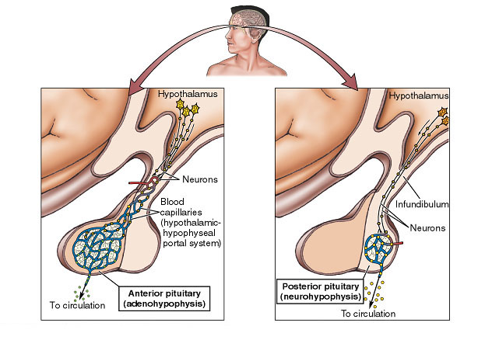
Hypothalamus: Control of pituitary function

Slide 14
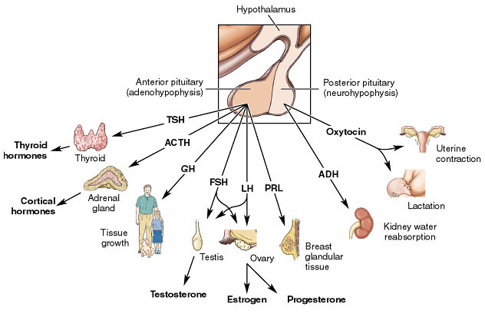
Pituitary gland

Slide 15
Checkpoint 13-2: What part of the brain controls the pituitary?

Slide 16
Hormones of the Anterior pituitary gland
Growth hormone (GH) or somatotropic
Thyroid-stimulating hormone (TSH) or thyrotropic
Adrenocorticotropic hormone
Prolactin (PRL)
Gonadotropins
  Follicle-stimulating hormone (FSH)
  Luteinizing hormone (LH)

Slide 17
Hormones of the Posterior Lobe
Antidiuretic hormone (ADH)
Oxytocin

Slide 18
Checkpoint 13-3: What are the hormones from the anterior pituitary?
Checkpoint 13-4: What hormones are released from the posterior pituitary?

Slide 19
Tumors of the Pituitary
Excessive number of tumor growth hormone (GH) cells in childhood
  Gigantism
Overactive GH-producing tumor cells in adulthood
  Acromegaly
Tumors that destroy secreting tissues
  Underactivity

Slide 20
The Thyroid Gland
Largest endocrine gland
Lateral lobes on either side of larynx
Connecting band (isthmus)
Enclosed by connective tissue capsule

Slide 21
Hormones of the Thyroid Gland
Thyroxine (T₄)
  Principle hormone
  Increases energy and protein metabolism rate
Triiodothyronine (T₃)
  Increases energy and protein metabolism rate
Calcitonin
  Regulates calcium metabolism
  Works with parathyroid hormone and vitamin D

Slide 22
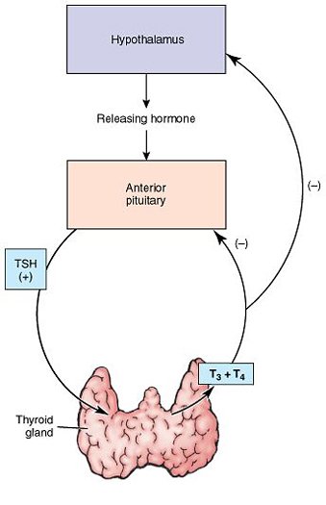
Thyroid gland

Slide 23
Disorders of the Thyroid Gland
Goiter is enlargement of thyroid gland
  Simple goiter
  Adenomatous or nodular goiter
Hypothyroidism
  Infantile hypothyroidism (cretinism)
Myxedema
Hyperthyroidism
  Graves disease
  Thyroid storm
Thyroiditis
  Hashimoto disease

Slide 24
Checkpoint 13-5: What is the effect of thyroid hormones on cells?

Slide 25
Tests of Thyroid Function
Blood tests
  Uptake of radioactive iodine
  Thyroid-stimulating hormone level
Oral radioactive iodine to measure accumulation in thyroid

Slide 26
The Parathyroid Glands
Four glands in posterior capsule of thyroid
Secrete parathyroid hormone (PTH)
  Works with calcitonin to regulate calcium metabolism

Slide 27
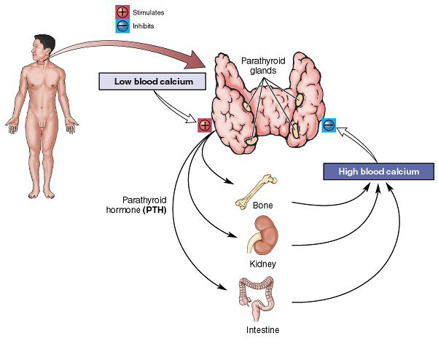
Parathyroid glands

Slide 28
Calcium Metabolism
Calcium balance requires
Calcitriol (dihydroxycholecalciferol)
  Produced by modifying vitamin D in liver then in kidney
Parathyroid hormone
Calcitonin

Slide 29
Disorders of the Parathyroid Glands
Tetany
  Inadequate production of parathyroid hormone (PTH)
Fragile bones and kidney stones
  Excess production of parathyroid hormone (PTH)

Slide 30
Checkpoint 13-6: What mineral is regulated by calcitonin and parathyroid hormone (PTH)?

Slide 31
The Adrenal Glands
Two small glands on top of kidneys
Each gland has two parts that act as separate glands
  Medulla
  Cortex

Slide 32
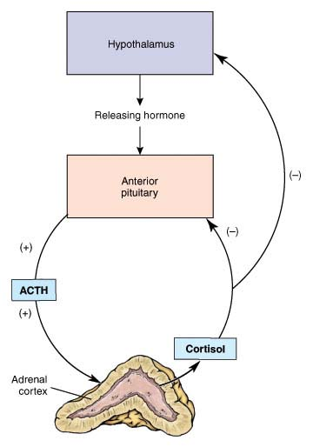
Adrenal glands

Slide 33
Hormones from the Adrenal Medulla
Fight-or-flight hormones
Epinephrine (adrenaline)
Norepinephrine (noradrenalin)

Slide 34
Checkpoint 13-7: The main hormone from the adrenal medulla also functions as a neurotransmitter in the sympathetic nervous system. What is the name of this hormone?

Slide 35
Hormones from the Adrenal Cortex
Glucocorticoids
  Cortisol or hydrocortisone
Mineralocorticoids
  Aldosterone
Sex hormones

Slide 36
Disorders of the Adrenal Cortex
Addison disease
  Hypofunction of adrenal cortex
Cushing syndrome
  Hypersecretion of cortisol
Aldosteronism
  Hyperfunction of adrenal cortex resulting in excess secretion of aldosterone

Slide 37
Checkpoint 13-8: What three categories of hormones are released by the adrenal cortex?
Checkpoint 13-9: What effect does cortisol have on glucose levels in the blood?

Slide 38
The Pancreas and Its
Hormones
Islets of Langerhans are specialized pancreas cells that secrete
Insulin
  Lowers blood sugar level
  Stimulates manufacture of amino acids into protein
Glucagon
  Increases blood sugar

Slide 39
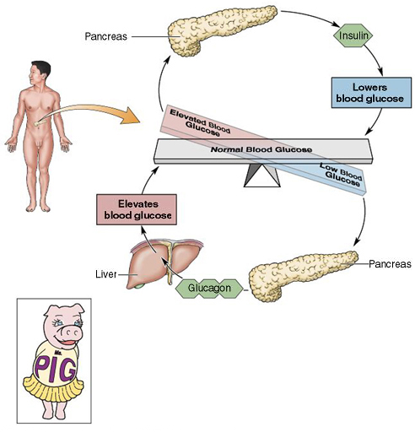
Pancreas: Islets of Langerhans

Slide 40
Checkpoint 13-10: What two hormones produced by the islets of the pancreas act to regulate glucose levels in the blood?

Slide 41
Diabetes Mellitus
Most common endocrine disorder
Insulin-dependent diabetes mellitus (IDDM)
  Type I diabetes
  Less common but more severe
Non-insulin-dependent diabetes (NIDDM)
  Type II diabetes
Gestational diabetes
  Usually disappears after childbirth

Slide 42
Checkpoint 13-11: What hormone is low or ineffective in cases of diabetes mellitus?

Slide 43
The Sex Glands
Ovaries and testes produce hormones to
Develop sexual characteristics
Maintain reproductive organs

Slide 44
Hormones of the Sex Glands
Male sex hormone
  Testosterone
Female sex hormones
  Estrogen
  Progesterone

Slide 45
Checkpoint 13-12: In addition to controlling reproduction, sex hormones confer certain features associated with male and female gender. What are these features called as a group?

Slide 46
The Thymus Gland
Mass of lymphoid tissue in upper chest superior to heart
Important in development of immunity
Produces thymosin
  Assists in maturity of T lymphocytes

Slide 47
The Pineal Gland
Cone-shaped structure posterior to midbrain
Produces melatonin
  Influences sleep–wake cycles
  Appears to delay onset of puberty

Slide 48
Other Hormone-Producing
Tissues
Substances that regulate body actions are also produced by
Stomach
Small intestine
Kidneys
Brain
Atria of heart
Placenta

Slide 49
Prostaglandins
Group of hormones made by most body tissues
Produced, act, and rapidly inactivated in or close to origin
Constrict structures
Dilate structures
Promote inflammation

Slide 50
Checkpoint 13-13: What are some organs other than the endocrine glands that produce hormones?

